Slide 1
Chapter 30 Capacitance

Slide 2
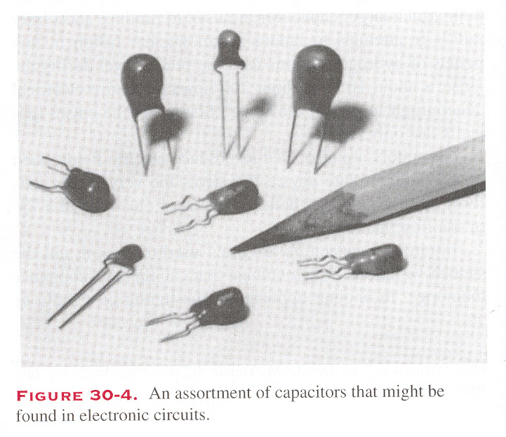
Capacitors
A cup can store water
A device that stores charge (and then energy in electrostatic field) is called a capacitor.

Slide 3
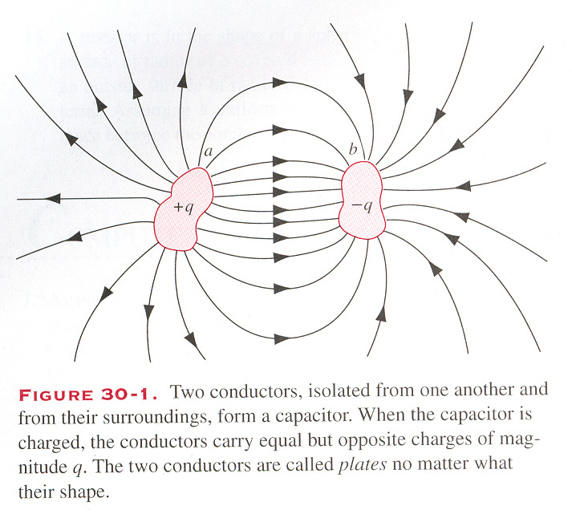
A capacitor consists of two conductors a and b of arbitrary shape:
These two conductors are called plates (no matter what their shapes).

Slide 4
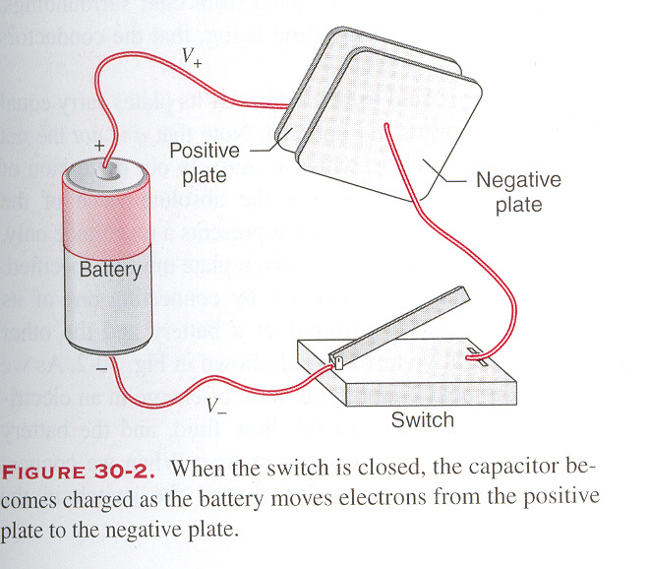
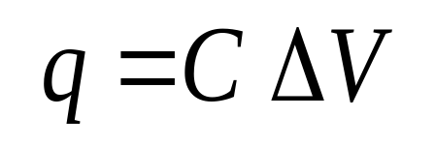
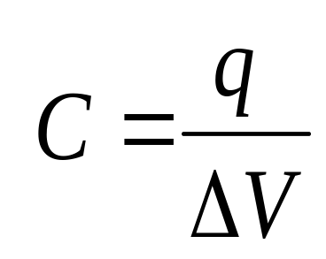
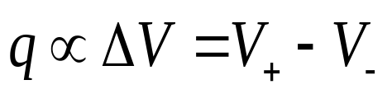
Symbolically, a capacitor is represented as:
C stands for the capacitance of the capacitor.
C
or
C
The charge q appears on the capacitor plates
The charge q is always directly proportional to the potential difference ΔV between the plates
Remarks :A capacitor is said to be charged if its plates carry equal and opposite charges +q and -q. q is not the net charge on the capacitor, which is zero.
There is a potential difference ΔV between the plates
capacitance

Slide 5
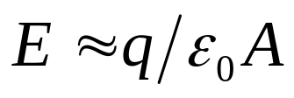
The capacitors can be used to produce electric field.
⊕
⊕
⊕
⊕
⊕
⊕
+q
−q
For the time being, we assume that the plates of a capacitor exist in a vacuum.

Slide 6



In circuits, capacitors are often used to smooth out the sudden variations in line voltage that may destroy computer memories.
V

Slide 7
The capacitance is a geometrical factor that depends on the size, shape and separation of the capacitor plates, as well as the material that occupies the space between the plates.

Slide 8
The capacitance is a geometrical factor that depends on the size, shape and separation of the capacitor plates, as well as the material that occupies the space between the plates.
The SI unit of capacitance is farad :
1 farad = 1 F = 1 coulomb/volt
1 μF = 10⁻⁶ F
1 pF = 10⁻¹² F

Slide 9
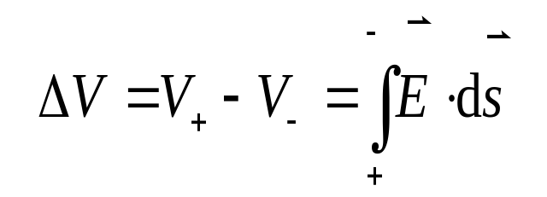
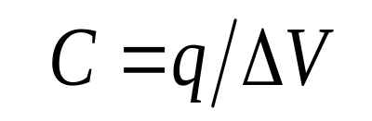
Calculating the capacitance
Procedure:
Suppose that the capacitor is charged, with ±q on
the two plates respectively.
2. Find the electric field E in the region between the
plates.
3. Evaluate the potential difference between the
positive and negative plates, by using the
formula:
4.The expected capacitance is then:

Slide 10
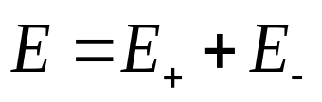
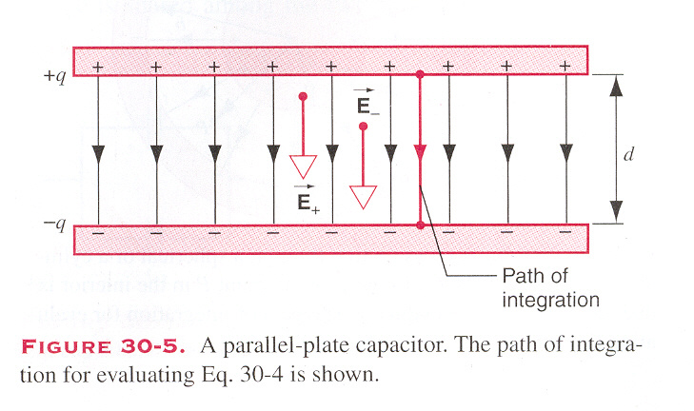
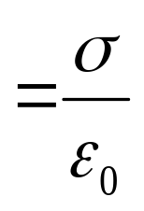
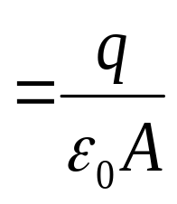
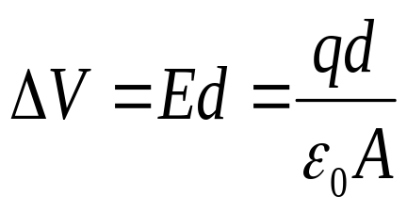
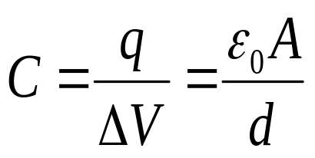
A Parallel-plate Capacitor :

Slide 11
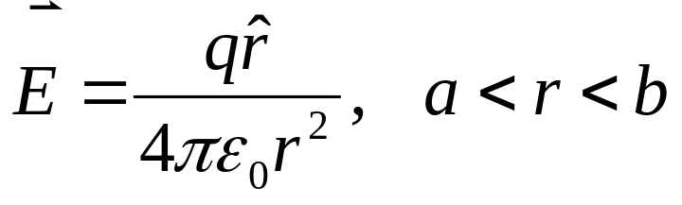
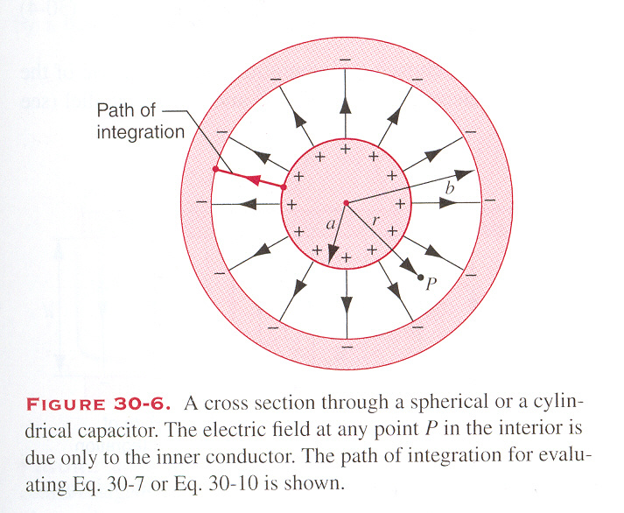
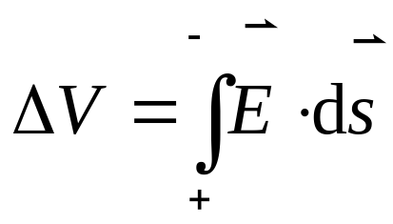
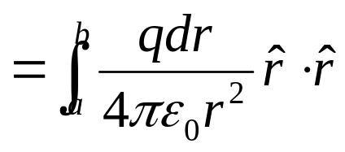
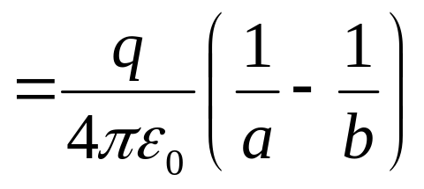
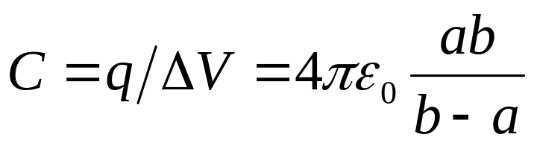
A Spherical Capacitor :

Slide 12
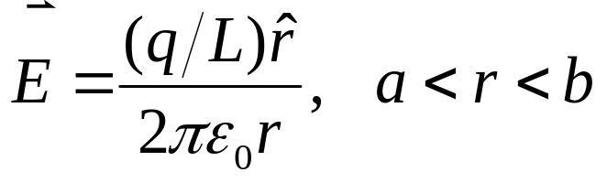

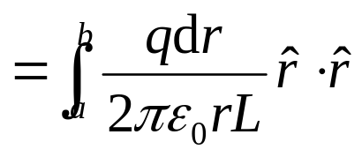
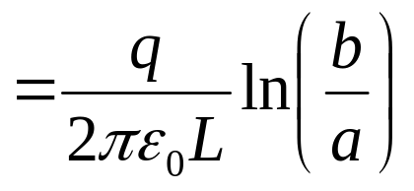
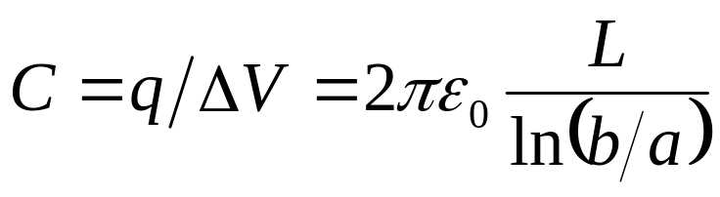
A Cylindrical Capacitor :
The capacitor has length L, and L>>b.

Slide 13


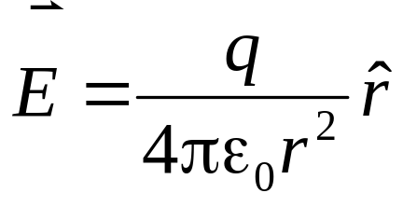
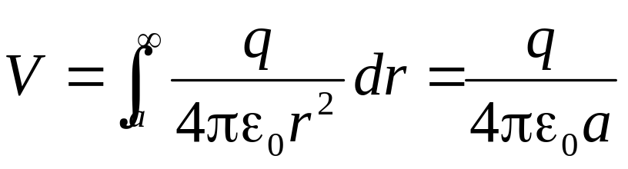
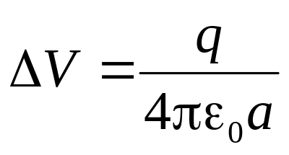
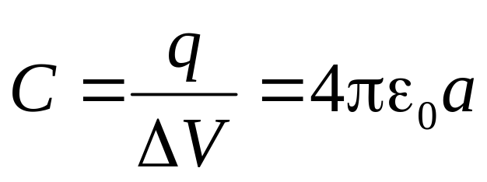
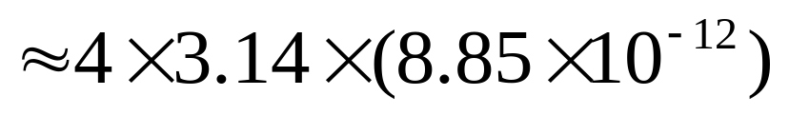
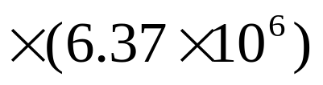
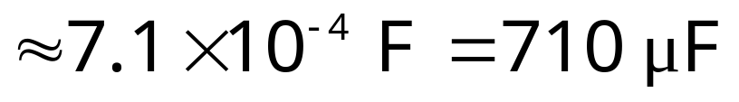
The capacitance of an isolated spherical conductor reads:
Example
a
What is the capacitance of the Earth, viewed as an isolated conducting sphere of radius R=6370km?

Slide 14
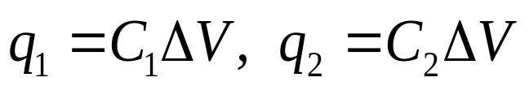
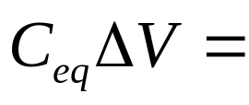
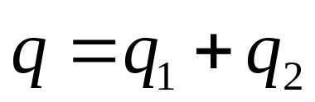
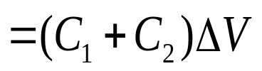
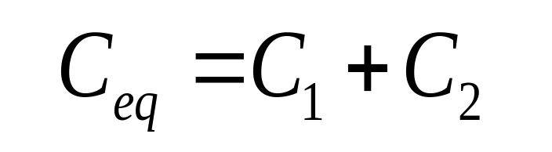
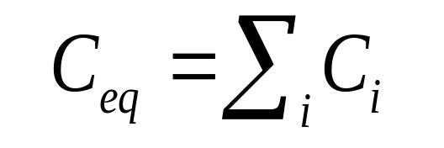
Capacitors in Series and Parallel
1. Capacitors connected in Parallel :
ΔV
C₁
b
a
C₂
Question: If we identify the above capacitors connected in
parallel as a single capacitor,
ΔV
a
b
what is its capacitance?
C_{eq}

Slide 15
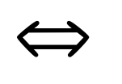
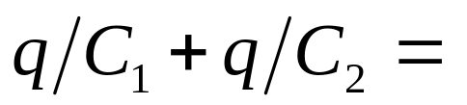
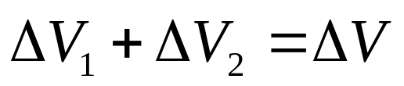
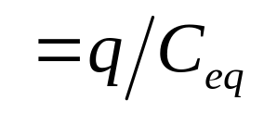
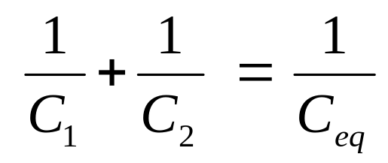
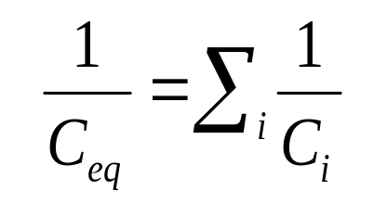
2. Capacitors connected in Series :
ΔV₂
ΔV₁
ΔV
q
−q
a
b
a
b
−q
q
q
−q
C₁
C₂
C_{eq}

Slide 16
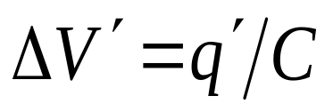
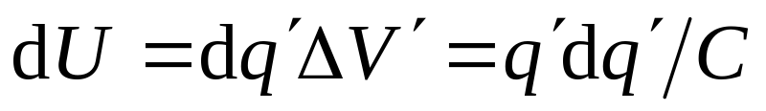
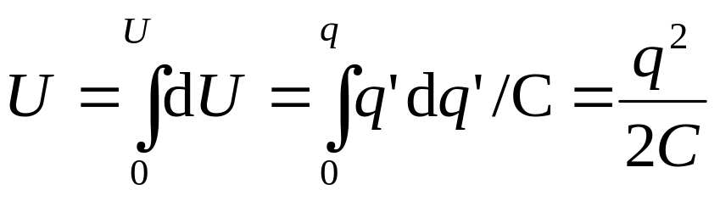
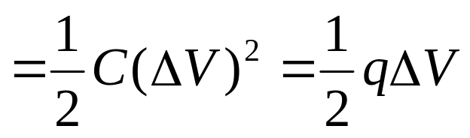
Energy storage
During the next time interval [t, t+dt], if an additional charge dq' is added on the plates, then the increase of the electrostatic energy is,
Suppose that at the instant t, the capacitor has been charged with charge q', the voltage between its plates is ΔV´.
dq′
q′
ΔV´
If the process is continued until a total charge q has been transferred, the total potential energy is:

Slide 17
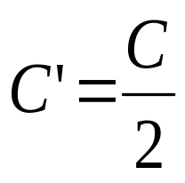
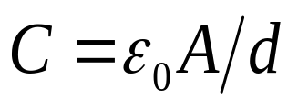








Why do we say that the energy is stored in the electric field between the capacitor plates?
Take the parallel-plate capacitor as an example.
charged with q, then:
double the volume
double the energy

Slide 18




Why do we say that the energy is stored in the electric field between the capacitor plates?
Take the parallel-plate capacitor as an example.
charged with q, then:
energy density

Slide 19


Why do we say that the energy is stored in the electric field between the capacitor plates?
Take the parallel-plate capacitor as an example.
charged with q, then:
energy density

Slide 20


Energy storage
Charge storage
Charge storage
Electric Potential
Electric field
Energy storage
Energy storage

Slide 21







Example
An isolated conducting sphere of radius R carries a charge q.
How much energy is stored?

Slide 22





Example
An isolated conducting sphere of radius R carries a charge q.
How much energy is stored?

Slide 23









What is the radius b of an imaginary spherical surface such as one thirds of the stored energy lie within it?

Slide 24






Capacitor with Dielectric
q
We now consider the effect of filling the interior of a capacitor with a dielectric material
-q
The effect of the dielectric material is to reduce the strength of the electric field in its interior from the initial E₀ in vacuum to E =E₀/k_{e}.

Slide 25




q
ΔV
−q

Slide 26





q'
q
ΔV
−q
−q'
If the potential difference between the capacitor plates are the same, the electric fields inside the capacitor are the same also.

Slide 27



q
−q

Slide 28


Dielectrics and Gauss’ Law

Slide 29




Dielectrics and Gauss’ Law
A dielectric slab is inserted,
Gauss’ law should be amended as:
q ’ is induced surface charge.
k_{e}ε₀ instead of ε₀ .
The charge q contained within the Gauss surface
is taken to be the free charge only.

Slide 30











Example

Slide 31
Exercises
P695 27
Problems
P 696~699 6, 9, 20, 24

